Slide 1
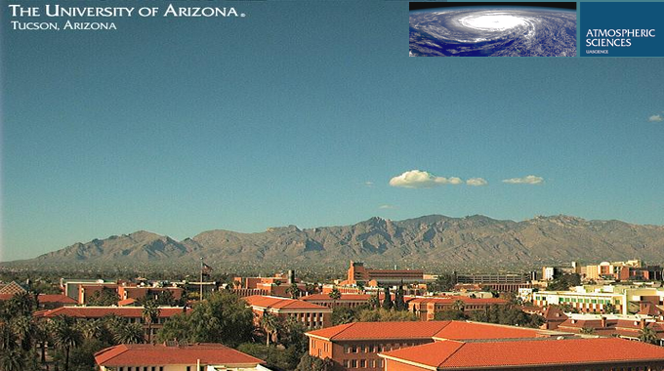
Analysis of Aerosols for Mining Sites
in Southern Arizona
Mary Jones
NASA Space Grant Symposium
Phoenix, AZ
April 18, 2015
Notes:
Hi everyone, my name is Mary Jones.
I’m an undergraduate at the UA in Environmental Science.
I work in the Betterton Lab in the Atmospheric Sciences Dept. at the U.

Slide 2
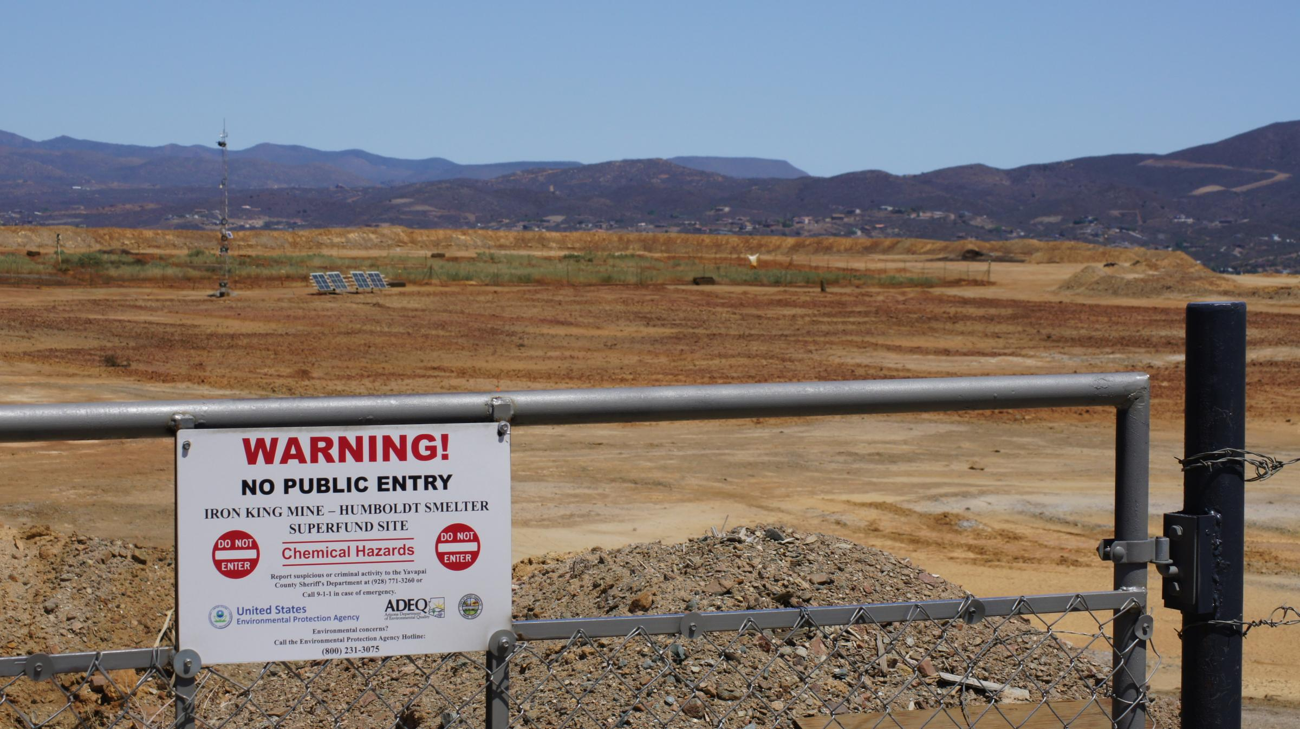
Background
Identification
Research
Clean-Up
Iron King Site, Dewey-Humboldt, AZ.
Notes:
The Superfund is the government’s program for cleaning up uncontrolled hazardous waste sites in the US.
There are three phases in the Superfund program: Identification, Research and Clean-Up.
The National Priorities List contains sites that are not yet classified as Superfund sites, but are of concern and require investigation.
Our research looks at a Superfund site and a site on the National Priorities List.

Slide 3
Project Overview
Aerosols: fine particles in the air
Organic: Carbon-Containing molecules
Known Substances of Concern:
  Arsenic and Lead
Unknown Substances:
  Hydrocarbons
    Natural (Levoglucosan)
    Anthropogenic (Benzothiazole)
Notes:
We collected and analyzed organic and inorganic aerosols generated by mining operations.
I’ll refer to aerosols a few times in the presentation. An aerosol is a fine solid or liquid in a gas. In this case, in the air. If you’d like, you can think of it as very fine dust.
My research, specifically, is focused on the organic portion of aerosol analysis - this is the first research of it’s kind for Tucson, AZ.
Just to clarify, organics are simply carbon-containing molecules.
Arsenic and lead are substances of concern at contaminated mining sites, but they may not be the only ones.
The research I worked on focused on characterizing aerosolized organic substances, specifically hydrocarbons.
You’ve heard the phrase, “everything in moderation?” In the case of hydrocarbons, the question isn’t just what is coming from these sites, but how much and in what ratios.
I’ll go into why we want to look at these, and more on what they are, a bit later. So where do these hydrocarbons come from?
To be clear, regulated substances (like arsenic, lead and certain hydrocarbons) are found in cities, too. Cars, industrial processes and other operations release these substances. However, cities must monitor this to ensure that the emissions are within safety guidelines. This is what gives us the ability to use Tucson as a background.
For areas with mining operations, though, there are a few more considerations to make.

Slide 4
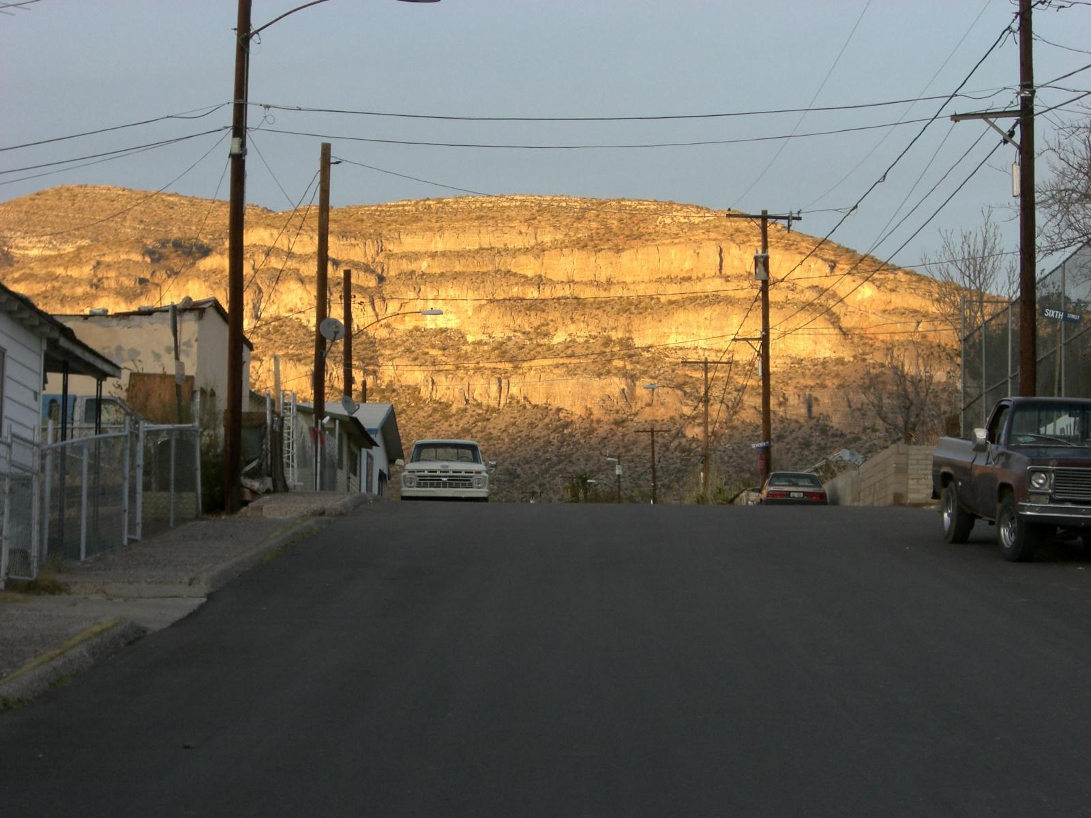
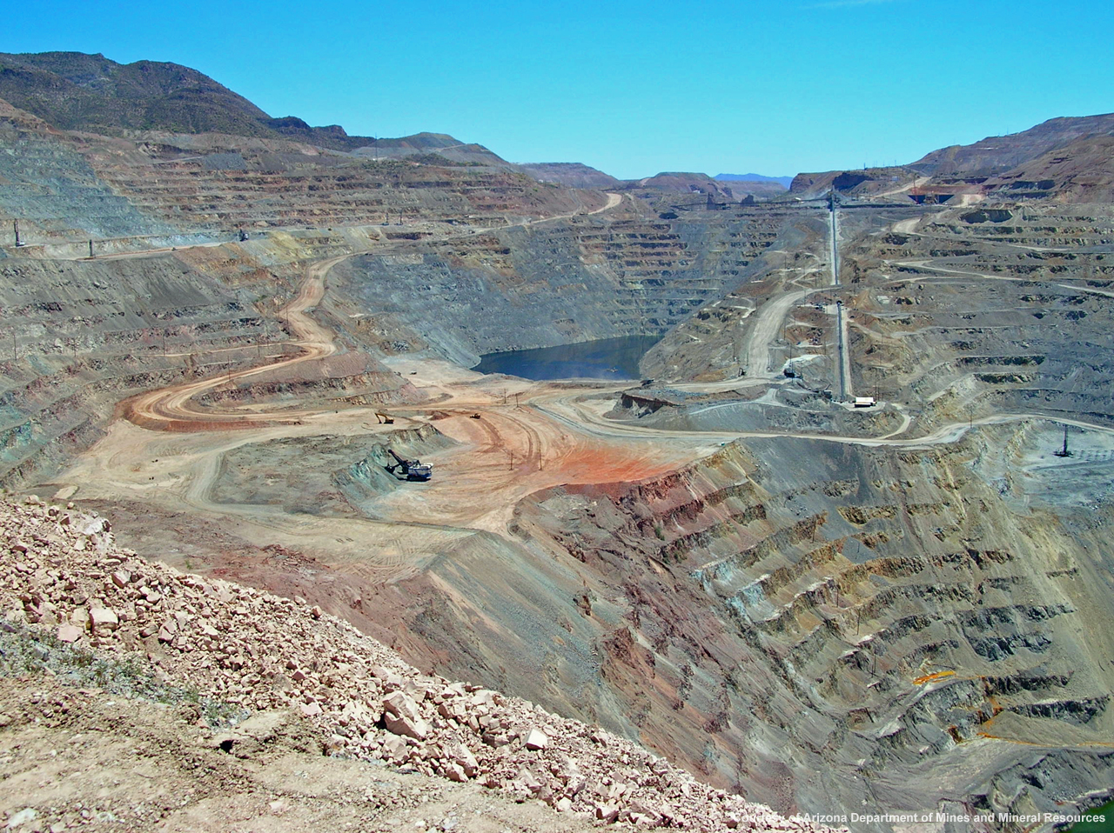
Sources of Aerosols
Mining
Tailings
Tailings mountain, Hayden, AZ
Ray Copper Mine, Hayden, AZ
Notes:
Smelting is a process used to extract precious metals from ore. This produces tailings as a byproduct by grinding, crushing, and melting rock (that’s not a mountain in the background…).
These tailings are piled near smelting operations and composed of fine grains. Because of the size and weather exposure of these tailings, they’re a source of dust.
The aerosols we captured include this dust.
The hazards posed by the dust depend on the materials that were mined.
If the substances dumped into the piles are relatively safe, then the tailings are considered clean.
If, however, the tailings contain metal oxides like arsenic and lead, or hydrocarbons they are contaminated and unsafe.
Let’s take a closer look at the sites chosen for this study.

Slide 5
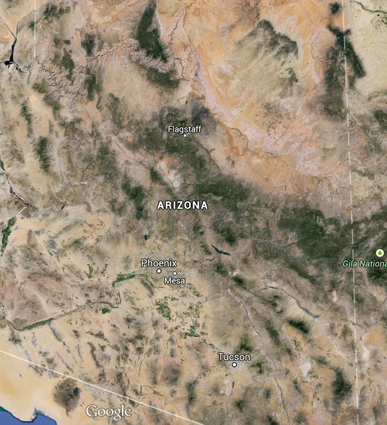
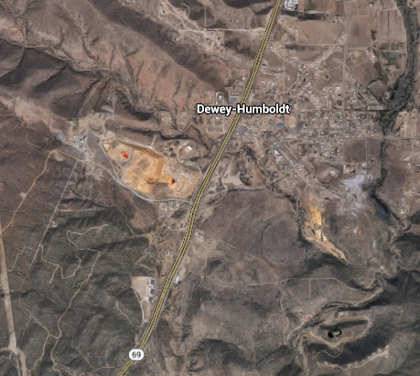
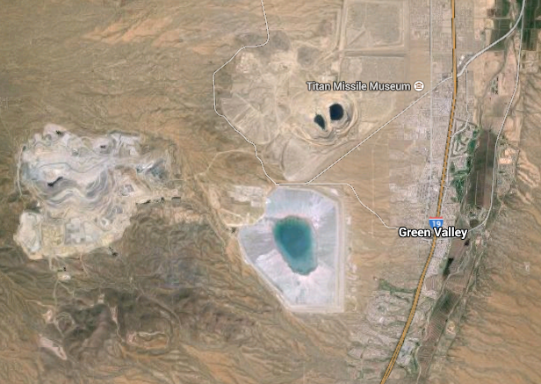
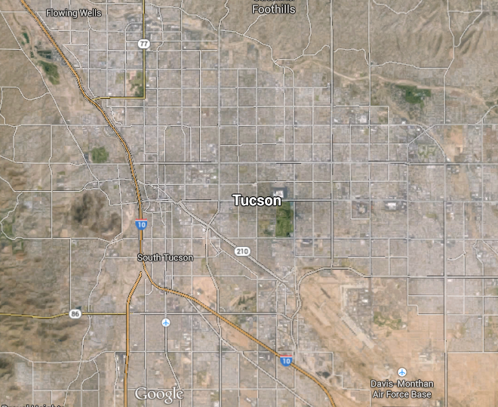
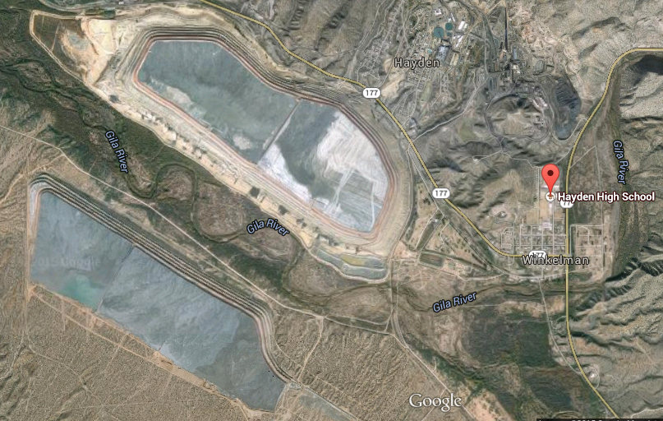
Sites
Iron King
(Dewey-Humboldt)
Hayden-
Winkelman
PAS
(U of A, Tucson)
Green Valley
Notes:
We have four research sites in AZ. Three of them associated with mining activity. These sites were chosen to provide a reasonable comparison for hazardous potential.
Our background was a site located on the UA Atmospheric Sciences building. This is an urban site. There are no mining operations within Tucson city limits.
We used Green Valley, AZ, as a clean mining operation comparison. This is a rural site.
Next, the Iron King mine in Dewey-Humboldt, AZ, is a rural, inactive mining site, but the mining and smelting left behind hazardous tailings. That is, there are
dangerous levels of arsenic and lead in the tailings at that site. This is a Superfund site.
Finally, Hayden-Winkelman is a rural, active mining site with contaminated tailings and smelter. This is the site on the National Priorities List.
Part of the purpose of this research is to determine whether the classification of this site needs to be changed to Superfund.

Slide 6
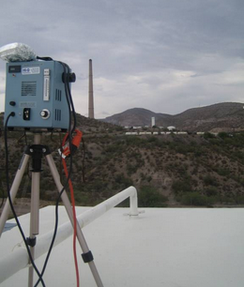
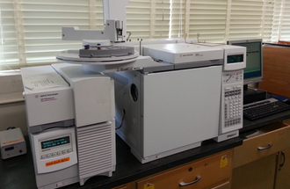
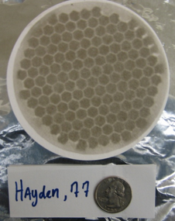
Chemical Analysis
Total Suspended Particulate samplers
Quartz fiber filters
Solvent Extraction:
Polar vs. Nonpolar
Analysis using GC/MS
View from Hayden HS, Hayden, AZ
Gas Chromatography and Mass Spectrometry
Notes:
To collect the aerosols, we set up Total Suspended Particulate (or TSP) samplers. These machines basically suck air into an opening at one end that holds a filter.
The quartz fiber filters provide us with a medium on which to capture the aerosols.
Once we run and collect the filters from their sites, we must extract the organics. To do this, we used GC/MS with polar methanol and non-polar heptane extractions.
We use chromatography because it is an analytical method for separating mixtures into their constituents.

Slide 7
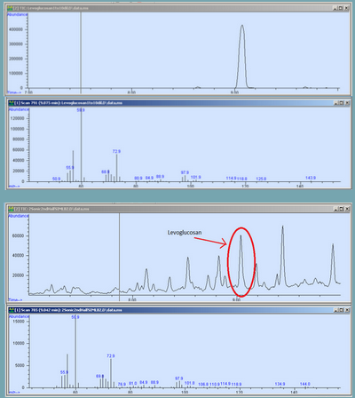
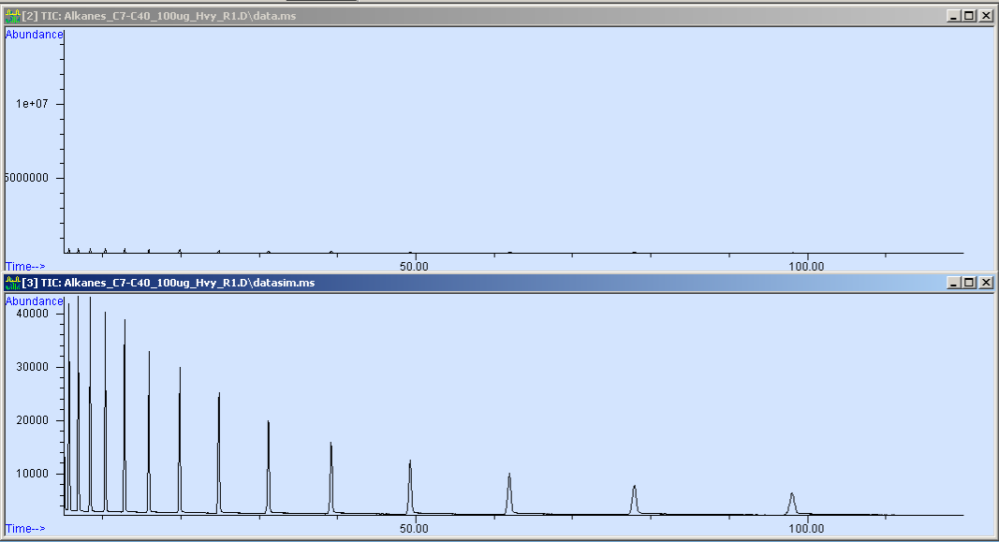
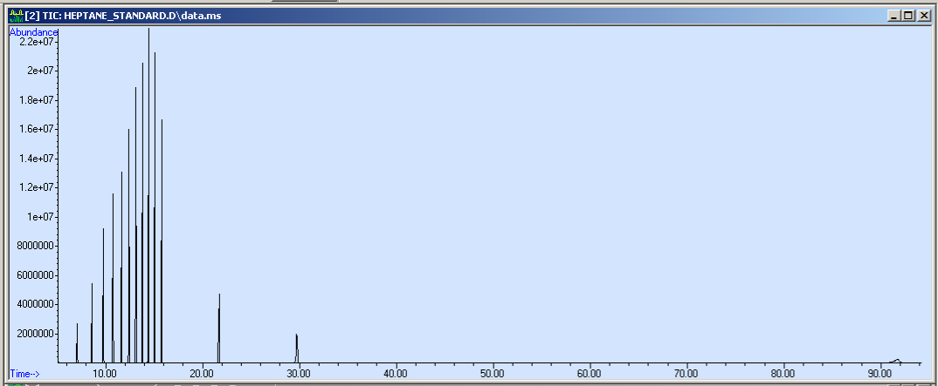
Interpretation
Levoglucosan Standard
PAS Roof Sample
Notes:
What we were looking for in this analysis was the presence of levoglucosan and the levels of other organic tracers.
We have standards that we run through the GC/MS. These provide elution times for the substances we run. That is, if the levoglucosan standard comes out at this time, then we know anything that comes out at this same time is also levoglucosan.
As an additional check, the mass spec provides us with a chemical signature that is compared automatically with an exhaustive online database. This confirms the identification of the substances with percentage of certainty.
The standards also provide calibrations for the concentrations of substances, and can be determined by taking the area under the curve of our results.
For levoglucosan, the test is simple: is it present or not?
Levoglucosan is a biomass-burning tracer. It only shows up in an analysis if the dominant form of elemental carbon comes from biomass burning.
Elemental carbon (or EC) comes from combustion. Combustion comes from either natural (like wood fires) or unnatural sources (like gas motors).
Levoglucosan helps us to determine whether or not the dominant form of elemental carbon is anthropogenic (human-caused) or biogenic (naturally occurring).
The other tracers are broad spectrum (including things like Benzothiazole and Cholesterol). We simply keep an eye out for any aberrant data as compared to our background site.
So what did our analysis tell us?

Slide 8
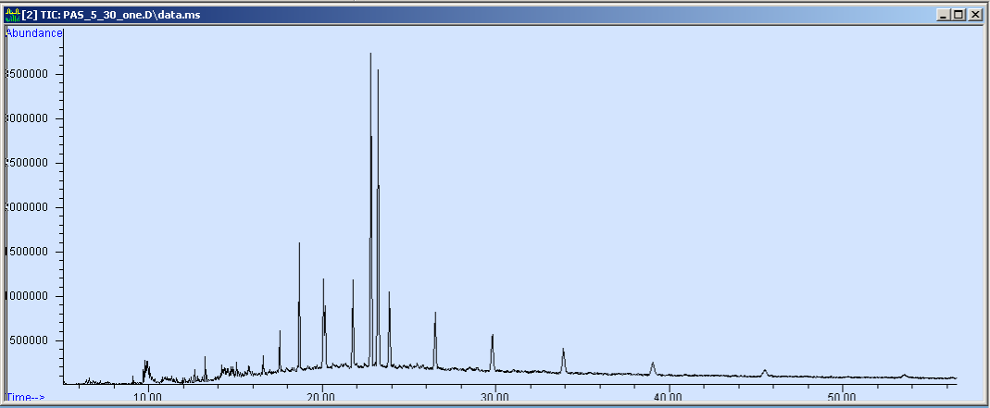
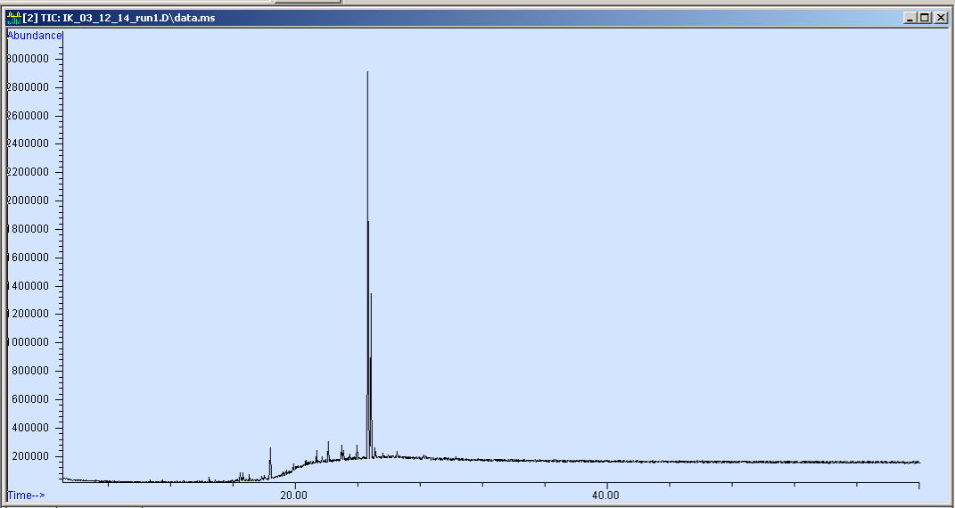
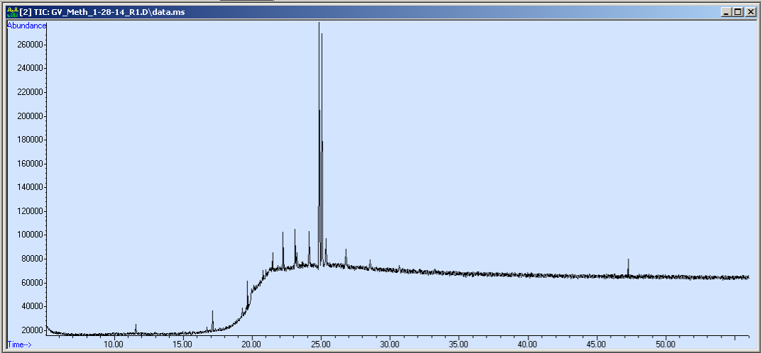
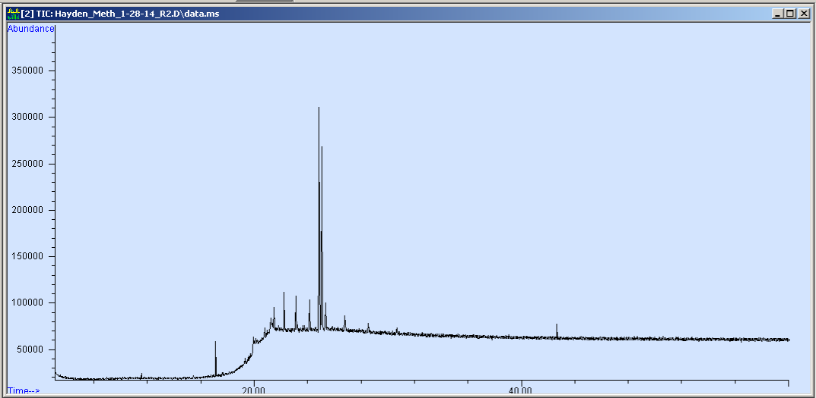
Results
PAS
Iron King
Green Valley
Hayden-
Winkelman
Notes:
Our preliminary research indicates that Hayden-Winkelman falls within an acceptable range for organic tracers.
The chromatograms from all the sites show that the results for the broad spectrum organic tracers analysis were within reason.
For levoglucosan, however, our results weren’t so innocuous.
You can see here that the Tucson chromatogram has a levoglucosan peak. This aligns with what we would expect because this sample was collected during the winter months when people use biomass burning to heat their homes.
Conversely, there is no peak in that region for Hayden.
What this means, in essence, is that the dominant volatile carbon signal wasn’t levoglucosan for Hayden. That indicates that most of the elemental carbon wasn’t from biomass burning, but from anthropogenic sources - like the mining operations taking place there.
This is important because it provides complementary data for the EC/OC analysis.
The next question is: what is the EC/OC ratio?
This will be discussed further by my colleague, Solianna Herrera, in the following presentation.

Slide 9


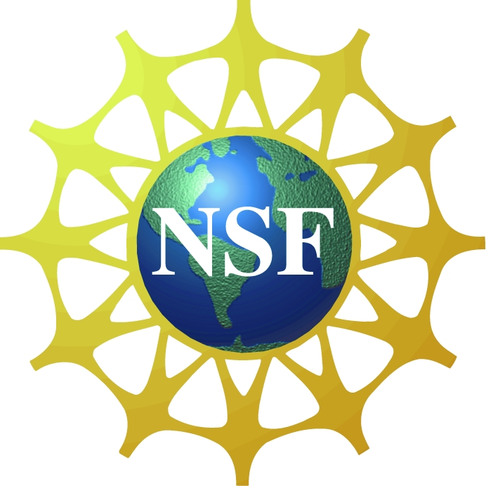

Thank you!
Special Thanks To:
Kyle Rine, Dr. E. Betterton, Dr. E. Saez, Chad Smith, Matt King, Dr. M. Stovern, Solianna Herrera, Victoria Raught, Sarah Warren, Sandy Holford, and Susan Brew.
Notes:
There are some people, listed here, that I’d like to thank and invite you to include them in your applause for this work.
I’d like to thank the NSF, NASA, the EPA and the Atmospheric Sciences Dept at the University of Arizona for their generosity and willingness to give me a shot at this science thing.
Thank you all for your time.

